Slide 1
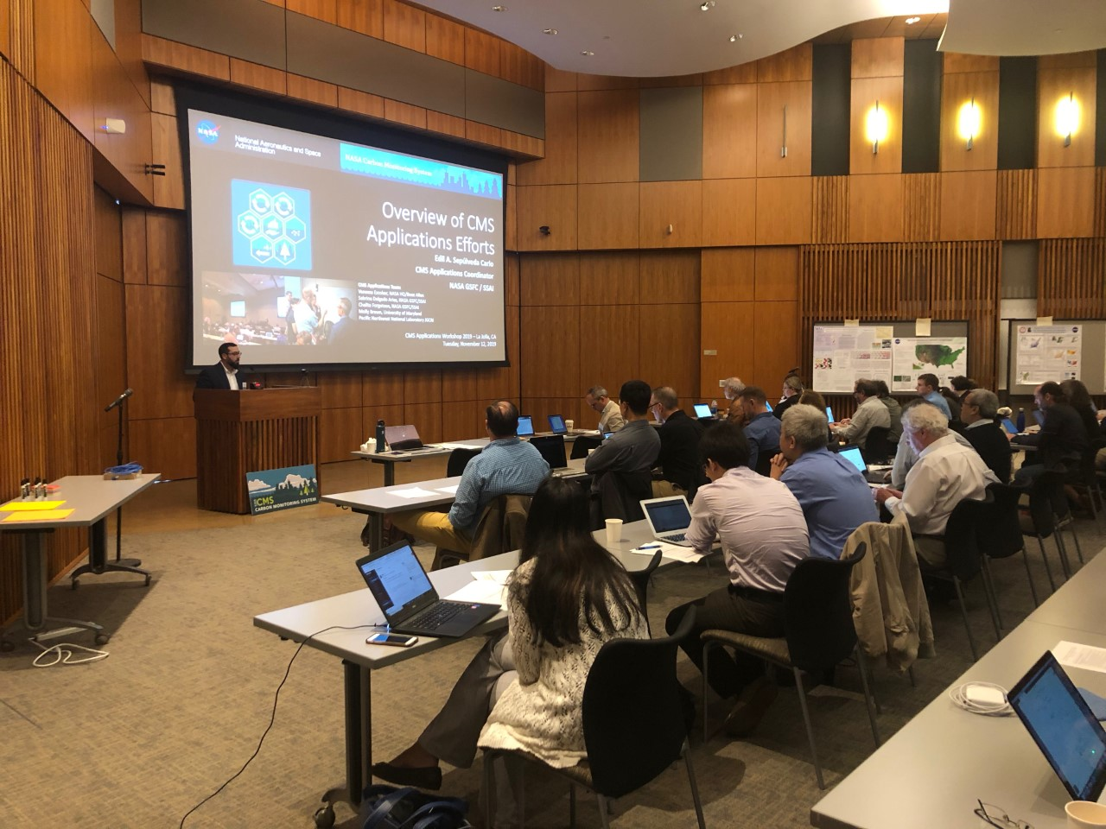
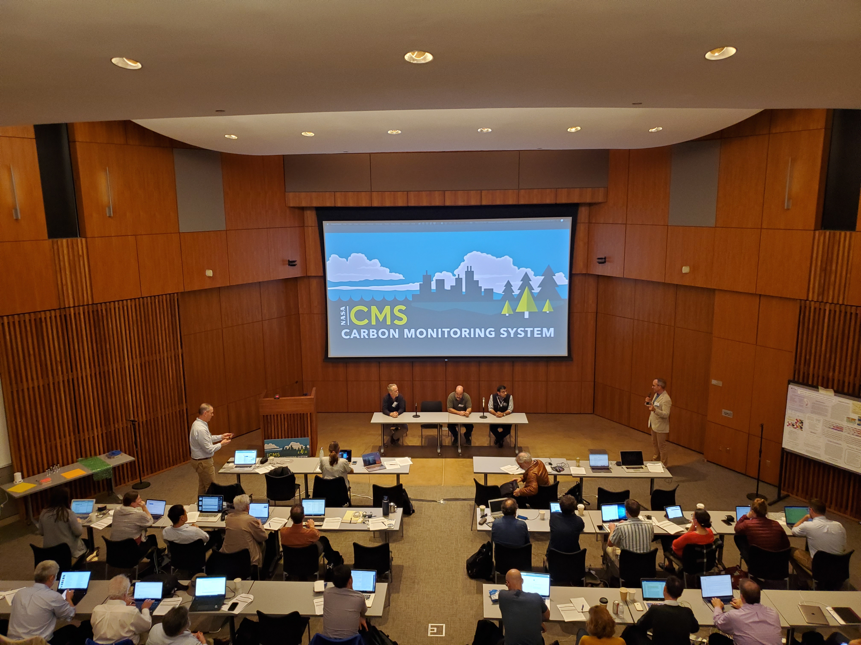
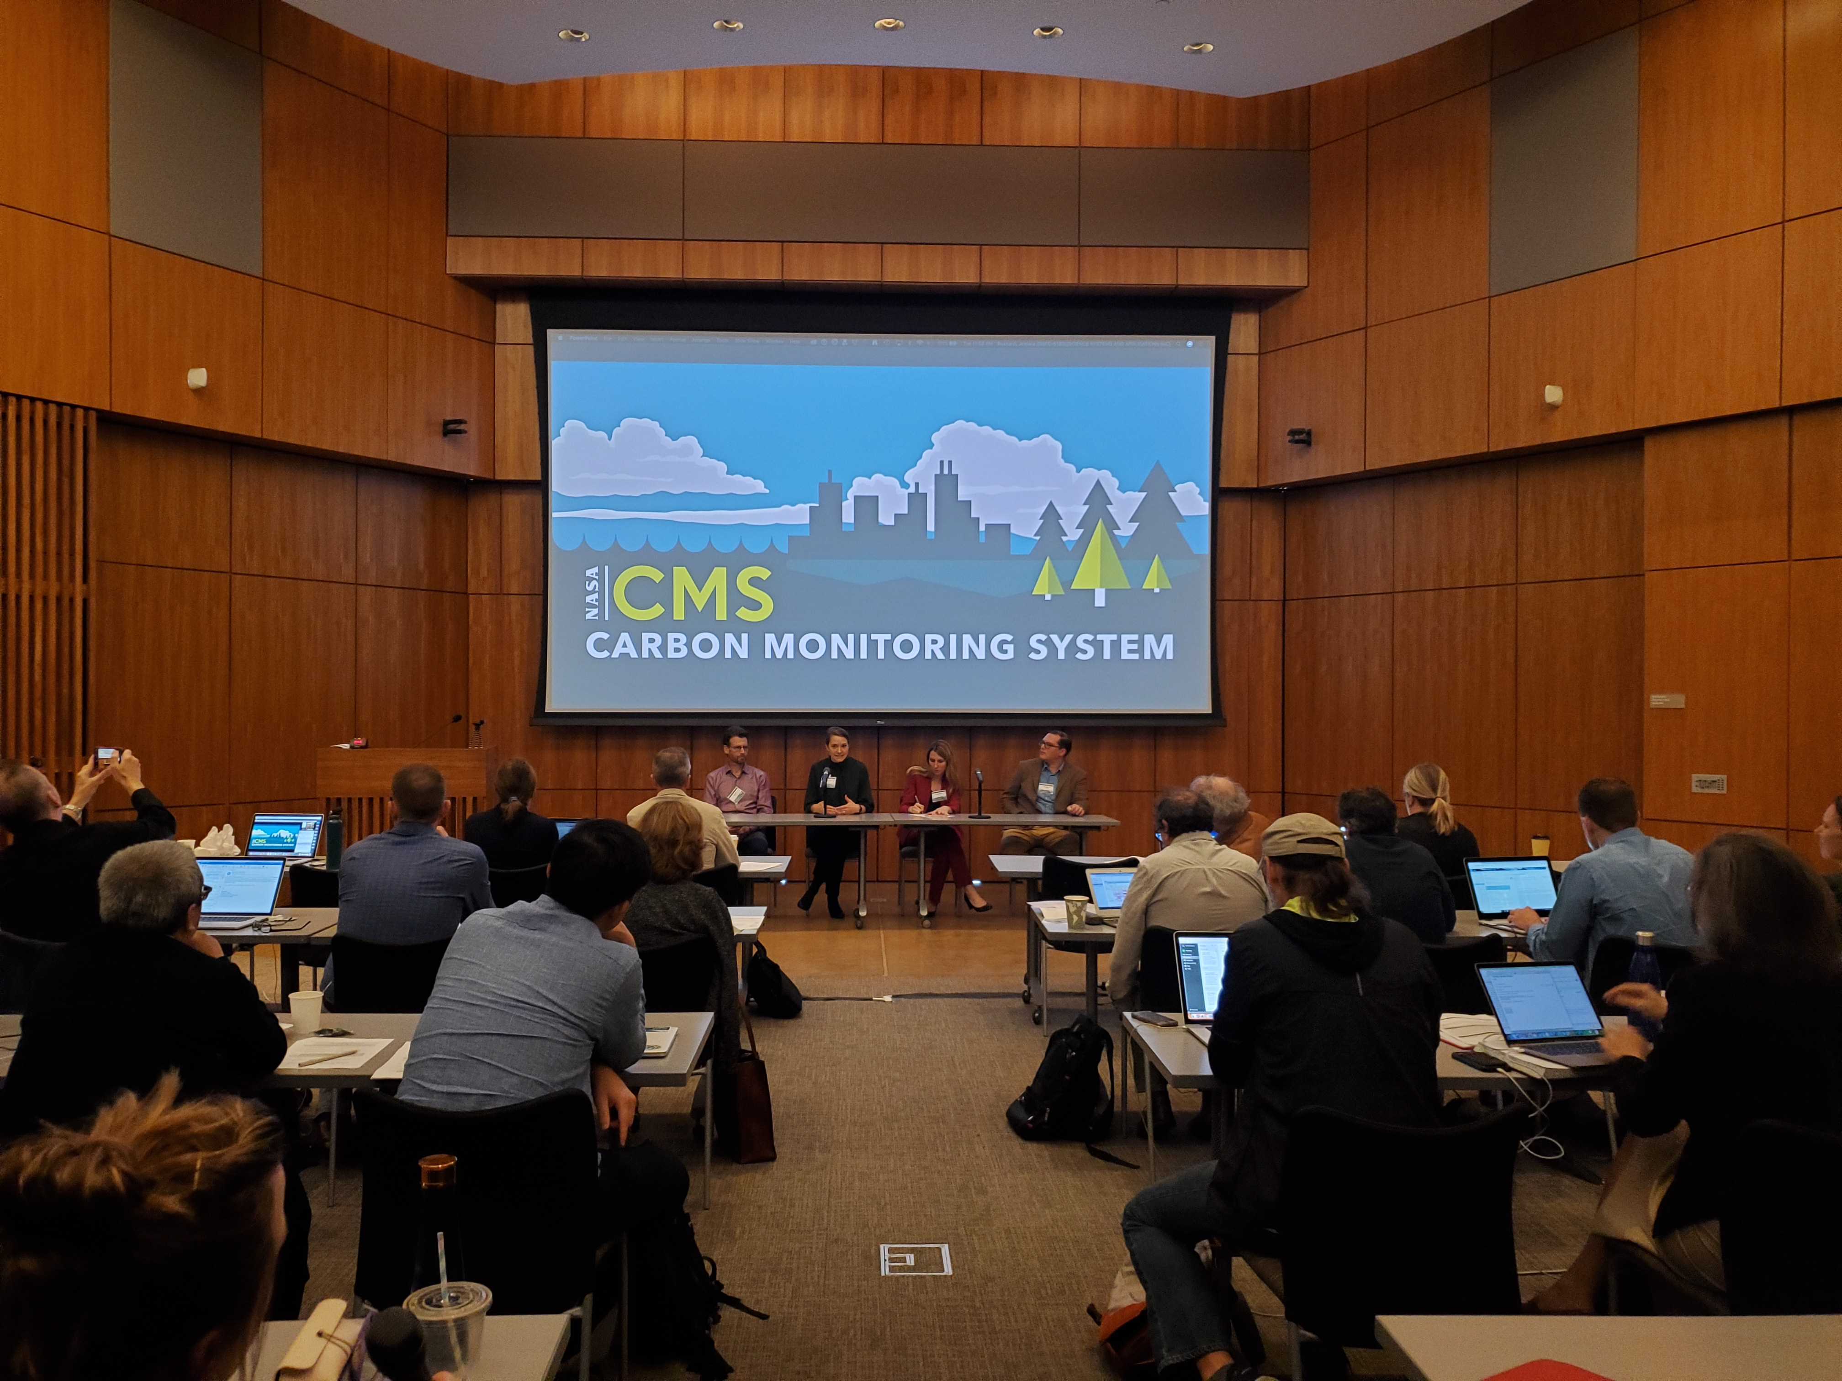
CMS Science Team Meeting & Applications Workshop
November 12-14, 2019 in la Jolla, CA
82 Participants
Edil Sepulveda Carlo (618), CMS Applications Coordinator, organized, moderated and presented during Day 1 of the meeting, the CMS Applications Workshop.
15 CMS Stakeholders presented on how they are using CMS data products, lessons learned and impact of the products for their organization, and further data needs, including:
California Air Resources Board, Illinois Farm Bureau, Maryland Department of Natural Resources, U.S. EPA, USDA Forest Service, Environmental Defense Fund, World Resources Institute, SilvaCarbon
Data Access Tutorial for CMS Stakeholders on Day 1, &
Data Submission Tutorial for CMS ST members on Day 2

Slide 2
Outcomes & Actions Moving Forward:
Workshop Summary for CMS Quarterly Newsletter – Feb 2020
CMS Applications Workshop Report/Proceedings – April 2020
Agenda, Slides, Recording, and Report to be Published in CMS Website – Spring 2020
CMS Stakeholder Fact Sheets with info about stakeholder organization, uses, impact, and data needs – Spring 2020
Creation of CMS Stakeholder Working Group
CMS Policy Speaker Series, Thematic Workshops, and Data Tutorials
CONTACT INFORMATION
Edil Sepulveda Carlo, CMS Applications Coordinator
301-614-6243
edil.sepulvedacarlo@nasa.gov

